Slide 1

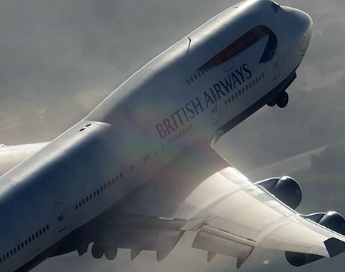
British Airways Virtual Internship
Analyzing the Customer Behavior based on their reviews
The dataset have trained by Random Forest Classifier.

Slide 2
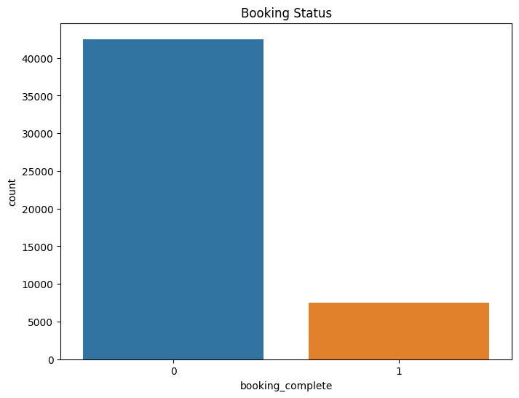

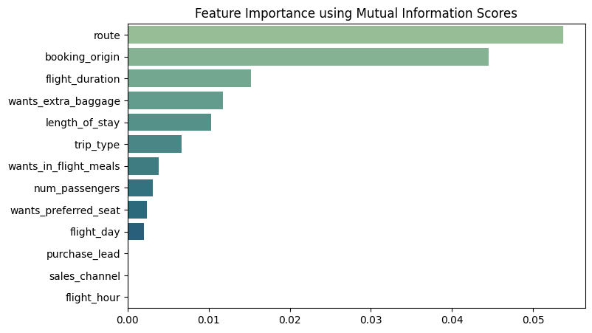
Customer Buying Behavior Prediction
The first graph displays the Booking Status, depicting the count of individuals who have completed the booking versus those who have not.\
The second graph illustrates the key features that exhibit dependency on the "booking_complete" attribute.
Top 5 features which influence
Customer buying behavior:
route
booking_origin
flight_duration
length_of_stay
trip_type
Training Accuracy: 99.98
Validation Accuracy: 85.17

